Slide 1
Introducing a new way to explore the evolution of human technology, cognition and organizations
A Fugue on the Theory of Knowledge
William P. Hall
President
Kororoit Institute Proponents and Supporters Assoc., Inc. - http://kororoit.org
william-hall@bigpond.com
http://www.orgs-evolution-knowledge.net
Download full presentation from
http://tinyurl.com/lu3y9yl
Access my research papers supporting the book from
Google Citations

Slide 2

Introducing a new way to explore the evolution of human knowledge and technology
This Meetup is an experiment!
  to road test the draft content of a hypertext book
  to introduce the theory of knowledge and cognitive revolutions
  to explore the history and philosophy of knowledge and technology
  to learn/demonstrate how technology made us human and how we became what we are, and
  to see if I can guide you through a vast and exciting cognitive landscape and hope that you will think it is as exciting as I do
  I hope it will be entertaining and make you think
Notes:
I might as well kick off. I think most of you have figured out by now who I am.
I'm trying something new, I've got a major book nearly finished, and I need feedback. It's a new kind of book, Its one I cannot publish as a paper document, because it's a hypertext. It uses a lot of ideas that I came to understand and use when I was managing knowledge for Tenx Defence when they were building the ANZAC Frigates here in Melbourne.
I had a job there managing their maintenance documentation. I had to put it into a computer system because the maintenance on the ships was managed by the computer system. Everything that was written about how to do the maintenance procedures had to be understood both by the people and by the computers, and this is where I learned about structured text. HTML is a very simple version of what I actually used. When I got to the point of writing the book I decided to see if I could do it, and yes, it actually worked pretty well.
But in terms of publishing, and whether this kind of text is actually going to prove readable for people who are interested in reading it on a screen, do a road test.
That's basically what the book is, it's a big hypertext. It's connected to a staggering amount of knowledge on the web, to be browsed to whatever degree the reader is interested. I've provided the links that can open up whole worlds if you are interested in going off in that direction. I expect that it will take people a very long time to read the whole book, and I doubt very few people will. But by browsing in the content you might learn a lot.
From my background, I'm an evolutionary biologist. [I] worked for the last 17 1/2 years of my career in organizational knowledge management with engineering and maintenance knowledge for very concrete things like ships. So I'm combining those threads and exploring the history and philosophy of knowledge and technology. I'll gradually get into how I happened to go down that path, because it's not simple.
Basically the book explores that history and philosophy, and hopefully it will provide an environment in which you learn about technological evolution and actually see a demonstration of how this hypertext works in practice.
As an evolutionary biologist, I'm particularly interested in seeing how humans came to be what we are today. In the process I want to see if I can serve as a sherpa or a guide to take people through what I find to be a pretty marvellous landscape, and hope that readers will find it as exciting as I do. In these sessions I gonna hope that the format is entertaining and makes you think.

Slide 3
Tonight’s Meetup
What resources are on offer in this exercise?
Introduce ourselves
  Who I am, what do I offer, and what do I hope to gain?
    I’ll do this more thoroughly in Session 2 when I talk about how the book came to be written.
  Who are you?
  What would you like to get from this intellectual exploration (answer later)
What is a hypertext fugue?
What are the key threads and how are they interwoven to turn a book into a fugue?
Project outline
Notes:
Tonight I think is basically introductions.
{And] explain a little bit about the hypertext idea and do an outline of the book and the project so you've got some idea about the overall structure.

Slide 4
Project resources
Me and my living knowledge
You and your living knowledge
Our social networks
Our cognitive tools and connections to network infrastructure
The “university” and its connections to network infrastructure
The book and its connections to the Web
The World Wide Web and everything that is in it
Notes:
I see this Meetup series as a project. It is an experiment, and I have no idea whether it is going to work, and it is entirely up to you people and hopefully others who come along as it developes to tell me if it works or not.
So, the resources of the project are me, what’s in my head, and a hell of a lot of other stuff that I link to my head through this new technology, which by the way I did not grow up with, but was invented after I was out in the world, professionally. Our social networks, the quantity of tools and connections we use to connect with network infrastructure, whether we are talking about mobile phones or old-fashioned books. They university and its connections with network infrastructure.
Because it really presents the picture I want to show how the book works I need to be connected with the Internet in a presentation type format like we've got here. So it takes a university classroom. Universities have lots of other resources like libraries, network infrastructures, and so on.
A major resource in the project is the book itself, and the connections from it to all kinds of different things in the World Wide Web. This is an entry into the world of human knowledge.
I will argue down the line that at this point assuming that you have a good university library subscription that allows you to access electronic content. I would say .probably 80 to 90 percent of the relevant scientific and scholarly knowledge is essentially instantly accessible if you ask the right questions.
I know it, I've been using it. That's how I have written the book. The book has taken me something like 15 years after I started it.., I didn't work on it all that time, of course, but that's when the idea first came to me.

Slide 5
Application Holy Wars or a New Reformation -
A Fugue on the Theory of Knowledge
  Based on 70+ years observing nature, studying & teaching science, working in a variety of organizations and managing knowledge for them
  I began writing in 2001 and after several interruptions it is now close to being finished
    Combines theories of life, knowledge and evolution
    Explores the history of cognitive technologies
    Provides an evolutionary hypothesis explaining how some tool-using apes became us and how we formed knowledge-based organizations that transcend the sum of people forming the organization
    Considers our possible futures as our knowledge grows hyperexponentially
  Designed as a hypertext that is intended to allow its huge scope to be browsed and read in many ways from many different interests
Notes:
The title is Application Holy Wars or a New Reformation - A Fugue on the Theory of Knowledge.
My wife initially though that that was an absolutely crazy title. However, I will present an argument that that is absolutely descriptive of what I am trying to do and the domain I am trying to cover in this project.
I'm 75, OK?
The electronic computer was invented after I was born. I was in university about the time the first generation of electronic computers became semi-commercial. So, I've been there, done a lot, seen a lot; and I've certainly watched multiple technological revolutions take place in my lifetime.
So, that's some of the background I'm putting into it.
I actually began work on the book in 2001. Later on I'll describe the circumstances that led me to do that. The overall structure hasn't changed a lot. It pretty much follows the structure I conceived then. But obviously, the content has grown, and there have been a couple of major technological revolutions that have taken place since I started writing. I'm finding one of my difficulties is keeping up with the changes as they as I'm trying to finish off writing the tail end.
Basically I am combining theories of life, knowledge, and evolution. There is a very important theoretical under layer to what I am doing which I will talk about and bring to the fore about half way through the book.
I start out with exploring the history of cognitive technologies that humans use to extend our minds. Initially the tools like a hammer and lever were the tools we started with. But as humans evolved as language and ways of communication, tools for managing those .processes became much more important. They have evolved very much faster, given that tools themselves have facilitated the construction of yet newer tools, and more powerful tools. So, those themes will be developed, and towards the last part of the book is an evolutionary hypothesis where I explain hopefully a reasonably evidence based story how tool using apes, specifically very much like chimpanzees, became us.
Most of what accounts for that change is that the tools have so extended the physical capabilities of the body that we have become something which is.... Although physiologically we are still very closely related to chimpanzees, gorillas and bonobos, ecologically, humanity has totally taken over the entire ecosystem of the planet. So we're the biggest, baddest organisms that have ever lived on the face of the Earth.
So all that happened on the order of four million years, which in evolutionary time is almost the blink of an eye. And a lot of that has happened in the last hundred years, which is even more incredible.
I end the book by considering our possible futures, as our knowledge grows hyperexponentially. One thing that characterizes, science and universities and everything like that is that we are actually expanding the body of knowledge. Every year, we are expanding it ever faster. That raises some questions as well that need to be considered.
The book's hypertext is intended to allow this huge scope to be browsed and read in many different ways by many different readers, but there is an underlying thread holding it all together.

Slide 6
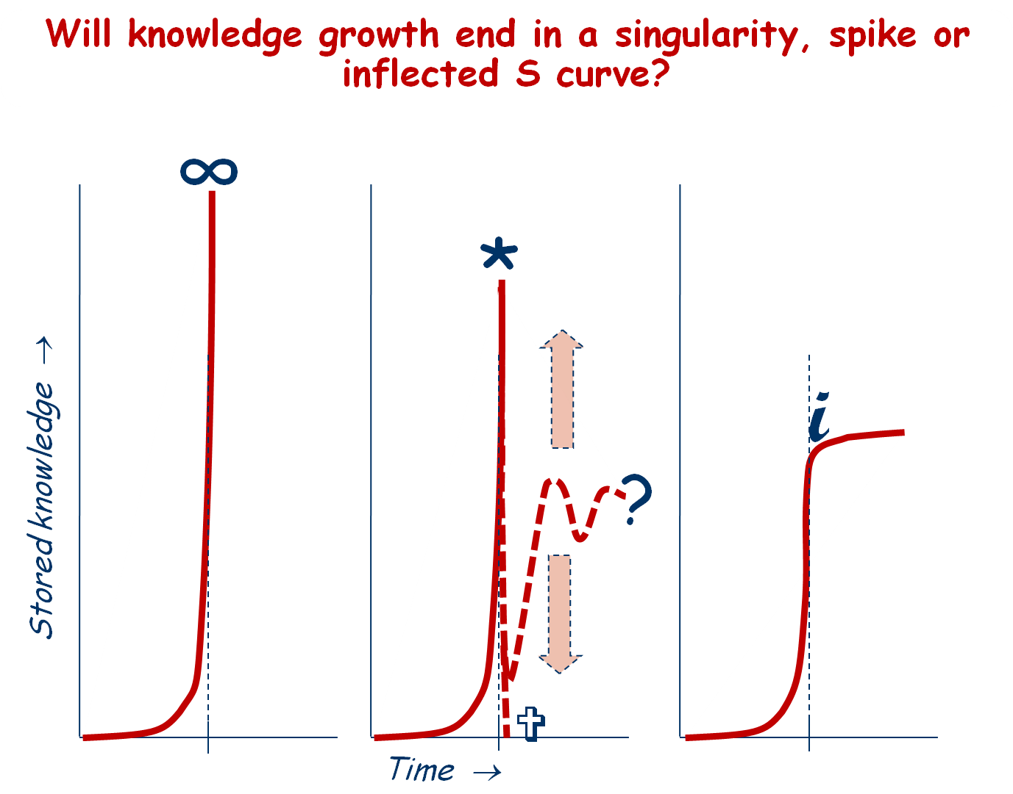
A question to ponder
Notes:
If you actually do read it as a book you'll see that thread
And I end up with this question.... You've got a lot of J curves there.
And at this point I think its very difficult to see what's going to happen in the next 50 years or by the year 2100 if there is still any ecology left to support humanity. Will our growing knowledge end in a singularity or we just go off the planet, or disappear into microspace or whatever, there's been some good sci-fi on that topic, or whether there's going to be an absolute ecological crash leading to extinction of humans following most other living things on the planet.
Or can we actually manage to stabilize at some point and develop a sustainable way to continue.
That's just a very brief introduction

Slide 7
Explaining the title
“Application”
  computer software designed to solve a class of problems
“Holy wars” (~ “flame war”)
  conflicts over competing knowledge paradigms or technologies that become heatedly emotional when protagonists do not focus on implicit aspects of world views associated with their different paradigms; often associated with scientific or technological revolution
“Reformation”
  improvement or transformation of existing institutions or practices etc; intended to make a revolutionary change for the better
  the revolutionary invention of printing technology facilitated the Protestant Reformation of the 16th century
“Fugue” (illustrated by J. S. Bach's "Little" fugue in G minor, BWV578)
  a compositional technique in two or more voices, built on a subject (theme) and possibly a counter subject (secondary theme) that are introduced at the beginning and recur frequently in the course of the composition
  the logical development in the book is modelled after a fugue
“Knowledge”
  solutions to problems of life
  what the book is all about
“Theory of knowledge”
  branch of philosophy concerned with the nature and scope (limitations) of knowledge, addressing the questions: What is knowledge? How is it constructed? How well does knowledge reflect external reality?
Notes:
That is what the book is all about.
It is from my background as a knowledge manager and as an evolutionary biologist. Because in one case I'm looking at genetic knowledge and in the other case I'm looking at objective knowledge or explicit knowledge stuff that's been put into documents.
To make sense of this hodge podge... to bring it all together is the theory of knowledge.
To wade through the swamp of paradigmatic disputes really have to have a theory underlying.
That's what the title says. It's an explanation of what the book is all about.

Slide 8
Background for the project
Combines threads from many disciplines in my background
  immersed in the ocean from the age of 5 when family moved aboard a boat
  studied physics for 2½ years from 1957 (failed because of maths dyslexia)
  started over in zoology (my life-long marine biology/natural history hobby)
  hands on first & second generation computers (analysis, flow-charting, etc.)
  neurophysiology research assistant for 3 years (intro to cognitive science)
  studying & teaching biology
    vertebrate & marine invertebrate biology, cytogenetics, genetics
    sophisticated user of library science products
    evolutionary biology (PhD Harvard, 1973), research & teaching to 1980
    theory of knowledge and history and philosophy of science (UoM 1977-79)
  organizational knowledge management
    technical communication and computer literacy training from 1981 (UoM)
    analysis and design of computerized authoring and content management systems from 1990 to 2007 with a key role designing systems to manage ANZAC Ship Project engineering technical data and documentation
    ANZAC Ship maintenance doco problems solved by 2000
Book writing - Holiday break 2000-2001
  time on my hands to think about difficulties in organizational knowledge management
  Result: started writing a hypertext book on co-evolution and revolutions in human cognition and cognitive tools humans use
Notes:
That's what led me to writing the book because I had innumerable difficulties convincing them that computer systems actually would actually work (and be) very valuable in their commercial business environment.
For a while in the late '90s they were being threatened that the delivery of ship 05, which was a major milestone in the contract when all the support engineering systems had to be approved and signed off or else there would be major liquidated damages claims, schedule delay and everything else.
The problem was the ANZAC Ships used computerized maintenance management system and we had humans writing the information that was supposed to go into them. Fifteen guys working full time for years are completely unable to produce two thousand maintenance procedures per ship without making an error that will cause the relational database that drives the computer system to cough and quit. So the Navy had a very good argument that without proper maintenance knowledge transfer their ships would not be safe to operate. And they were looking for an excuse at the time not to pay them so much and to delay the schedule themselves. So it was a very serious threat.
My job was to work out how humans could feed the detailed technical information into s computer system so it would work like it was supposed to and be readable by humans. Thanks to the line managers that were able to misallocate budget funds to fixing the real problems that were
Despite explaining the problem in all kinds of different detail to different people executives in Finance and Administration who owned the computer systems would not sign the contract to actually implement the system we had to have. They didn't understand the difference between paper and electronic documents, this very big paradigmatic gap. However, thanks to an operations manager who was prepared to pay the supplier time-and-materials, basically with no questions asked, to have the system implemented, we actually got it in... sorted out the data... made deliveries to the client they were very happy with... They're still using it today.
So much money was saved in the support engineering area the whole ANZAC Ship Project turned out to be profitable for Tenix Defence. The ships were finished on time according to the original contract... on budget against a very stringently fixed price contract. And that is something that almost never happens in the defence industry
So, when I solved that problem I had lots of time on my hands and the company was willling to keep paying me for three years with the understanding that I would spend at least a day a week at the university studying organization theory and knowledge management. So, they gave me the chance to start writing this book.
Because of the frustration... and the necessity for it was driven home by the fact as they were completing the ANZAC Ship Project the owners felt that they had no choice but to aucton off at fire sale prices their entire Defence assets for what had been a billion dollar defence industry player. They had a few other things so the company name still exists but the main part of the business....(garble). They had to get out of it, because they started a project a tenth the size of the ANZAC Ship for New Zealand... and couldn't build them. They didn't know how to build the ships.
Mind you, this is after the most successful defence project in Australian history.
They could not complete 7 much simpler smaller ships for New Zealand remotely on time or remotely within the budget that had been originally agreed to. So they got out.
Seeing this happen made me very, very, mad; because I knew the people, we knew the answers to the questions that caused the New Zealand project to fail. And I and my colleagues had made three separate attempts to set up knowledge management processes to transfer what the ANZAC Ship people had learned. The things that went wrong were the ones we thought would go wrong if the human knowledge wasn't actually transferred. But, because of these paradigmatic reasons the decision makers never understood the problem and weren't willing to accept that someone else did and we were actually making recommendations to the company that it very definitely needed to follow in order to keep the business successful.
I had a great time, and a lot of free time for writing the book because no one paid any attention to what I was proposing to do for them, so I didn't have too much work except to write proposals, so I spent the rest of my intellectual effort on the book.

Slide 9
“Application Holy Wars” is a fugal hypertext: a revolutionary format for sharing knowledge
Text displayed on a screen including clickable hyperlinks to other text or other objects that can be instantly accessed by a pointing action (mouse click)
  besides texts, hyperlinks may access tables, images, audio, video, and other presentational formats
  links may be other parts of the same document, or
  may be located anywhere in the World Wide Web
Hypertext is the underlying concept defining the structure of the World Wide Web.
The book is constructed as a hypertext living in the Web
  top layer of text is a fugally structured sequential argument providing a guided tour through many disciplinary paradigms
  direct links from the text to the Web mostly define and discuss the linked terms
  hyperlinked notes in the document offer additional information, explanations, arguments and web links
  text citations link to extensive bibliography where most references then link directly to the complete work being cited
The result is knowledge built from and directly connected to knowledge and wisdom held in the World Wide Web
Notes:
Until I ran into the problem that I had such a different view of what organizations were and how knowledge worked in them, I had to go back to answer those questions before I could finish the book.
So, how the fugue works, I'll have to talk about that in an other meetup.

Slide 10
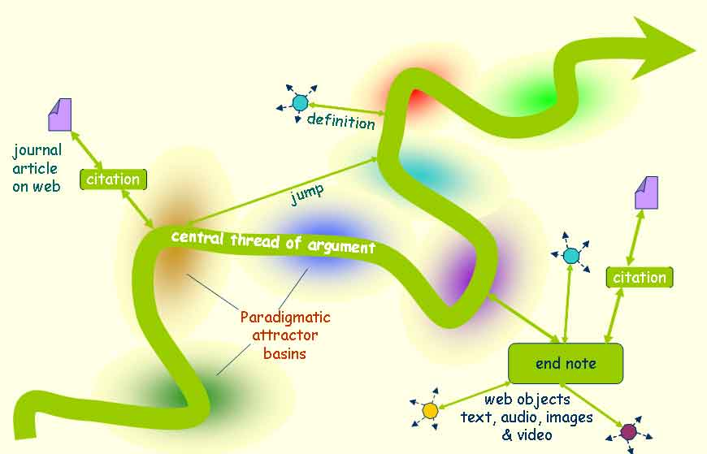
Hypertextually navigating the landscape of the web of knowledge
Paradigms are attractor basins in the topography of the global web of knowledge
Links to the web access knowledge objects that help us cross
paradigm boundaries towards unification
Notes:
The book is a meandering thread that goes through a number of different paradigmatic areas: Different kinds of knowledge, different kinds of technology, and whatnot.
As the book is written I try to provide a coherent historical and personal thread that crosses these various swamps and minefields, and whatnot. As you follow the thread there are all these branches.
My writing in many areas of the book is brief and dense because I don't go on to a lot of words describing things, but I point to definitions... I point to articles... I point to videos... I point to all kinds of objects that are out there floating around in the Web that are brought in to illustrate and elaborate and explain the central thread.
The book itself has three functionally different but very major parts:
[The main thread of narrative text]
A set of endnotes which are linked to the text where I say a lot of things that are interesting, but not immediately relevant to that bit of text, or where I try to delve into something that's theoretically difficult that if I'd developed it in the middle of the text it would slow down the narration. So the're these branches that can be followed if you want.
Many of the branches connect to the book's bibliography.
I haven't done the statistics yet, but something between 80 and 90 percent of the references I cite are available on line.
The book provides from the bibliography a direct on-line connection to the reference material. I have actually been able to find probably 50 to 70 percent of the articles I referenced free to the Web. And those links I give... The library ones you have to ferret out yourself if you've got a library subscription. The only thing you can't access electronically yet, are the majority of the books that I've cited. They're out there on line but copyright restrictions are such that getting access to them is pretty difficult.

Slide 11
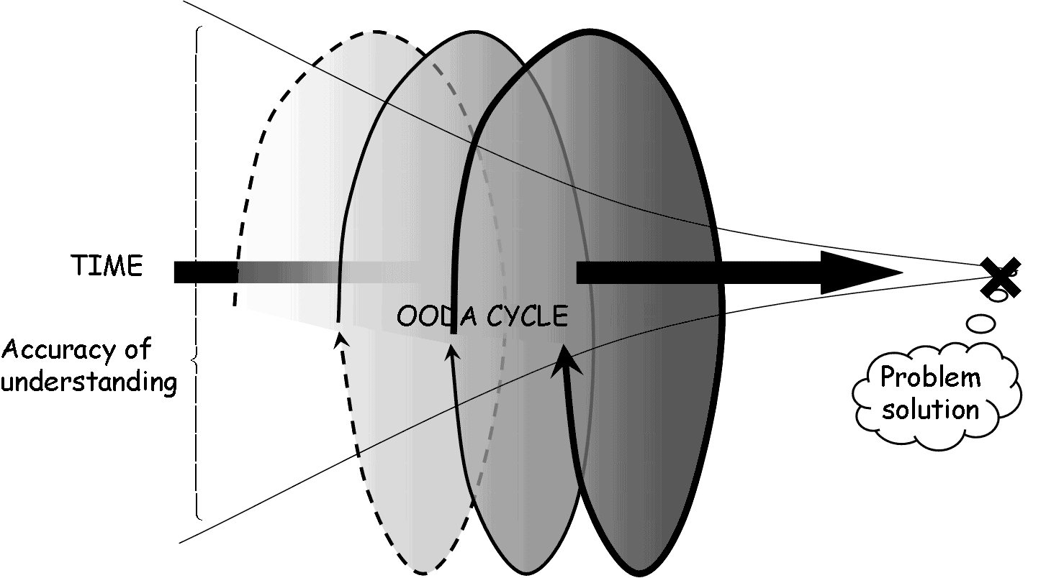
The central thread of the fugue is semi-recursive, forming a knowledge spiral
The figure is explained in the topic on autopoiesis in the book [Contents: Interlude / What is life / Autopoiesis ]
Notes:
Picture this screw working through the environment and through time. As we go round and round the loop the accuracy of the knowledge generated is improved.

Slide 12
History of the writing
Started serious work at Tenix Defence ~ Jan. 2001
  stimulated by a holy war in the technical writing community over the use of conventional paper-based word processing applications versus the newer semantically structured authoring environments based on SGML and XML
Working in industry I had no practical access to an academic library
  A structure of Subject, Counter Subject and 4 Episodes established early
  Concept was to link and distill freely available knowledge on the Web
  Worked very well for first three Episodes
  Took extended leave 2001-2002 for heavy-duty writing
    First three episodes flowed easily
    In Episode 4 I could not reconcile my understanding of Tenix with web-accessible literature on knowledge management or organization theory
    I could not resolve this without access to academic thinking and research libraries
Hon fellowships
  Research to develop a unified theory of organizational knowledge
  Monash 2002-2005 (1 day/week at Monash in 2003 on Tenix time)
  UoM 2005- (helped establish TOMOK, Melbourne Emergence, KIPSA)
  Retired Tenix mid 2007
  Many publications as I explored the theory and practice of organizational knowledge
By 2009 I understood the theory well enough to return to working on the book directly
Notes:
This slide goes through the history of the writing. I won't detail it here because I've already talked a lot about it but you can download the presentation.
Yeah..
[Question from audience] I would like you to clarify... also just wondering... I'm not really clear when you are talking about paradigmatic culture that's on credible...
Yeah, on my narration...
[Audience] So what would be an example of a paradigm?
OK... Different kinds of knowledge growth... Kuhn's scientific revolution versus Karl Popper's evolutionary theory of knowledge. Gradual development versus revolutionary change. It's all the same as knowledge... They use very different languages. and you get into philosophy, and frankly most philosophers do not understand Karl Popper's work. And that is probably for a theory of knowledge held by living things. That is by far, from my point of view, anyway, the most fundamental and accurate portrail of what knowledge is: It's solutions to problems of life
And, although Popper isn't a biologist he was a good friend of Konrad Lorenz, the ethologist who won the Nobel Prize, and Lorenz was also sort of an evolutionary epistemologist.
That's one set of paradigms
Another one is the paradigm between paper documents versus structured electronic documents. [These are] very fundamentally different, and today the different schools still do not talk well together because they don't understand the fundamental differences in how these work.
A third set of paradigms are between those knowledge managers who think that the only kind of knowledge that matters is tacit... living knowledge in people's heads. And then there's a whole other range of people from an information science background who think that the really critical information you have for knowledge is what's contained in documents.
Again the're flame wars going on for months and over a year in some cases in the knowledge management community over this kind of stuff.
Each of these swamps or paradigms or valleys, whatever you want to call them, they may use the same words but the language has different meanings. And they're not meanings that are visible on the surface of the discussion.
So these are paradigms.
[Other] sessions will deal with those areas in considerable depth. I don't want to talk about it too much now... prepared to introduce the ideas in so you know there's something there.

Slide 13
Outline of the Meetup Project
Notes:
I don't propose to go through the detail because I've already discussed it somewhat is the outline of the sequence of meetups I have scheduled.
Now at this point this is purely tentative. I've no idea how you will like it. If people decide it's too hard,... boring, insufficiently interesting, or whatever... well, y'know, I either change the approach, or we quit at some point.
But, this is how I see it laid out at present. So I suggest that you download the presentation.

Slide 14
Book organization
Fugal development around knowledge growth (learning) cycles
  SUBJECT: epistemology, learning cycles construct new knowledge, and revolutionary cycles of technology and knowledge growth
  COUNTER SUBJECT: knowledge and its value
  EPISODE 1: (historical) counting, writing, books, printing
  EPISODE 2: (historical) automating cognitive processes
  EPISODE 3: (historical) cognitive tools for individuals
  INTERLUDE (theory): systems, theory of living knowledge, hierarchically complex autopoietic systems/organizations
  EPISODE 4: (history and theory informed observation) social computing: moving posthumans into the cloud
  EPISODE 5: (history and theory informed observation) individuals forming societies and socio-technical organizations
  CADENZA: liberating knowledge, knowledge explosion and the “global brain”, organizational knowledge management
  CODA: is the singularity a spike or a point of inflection?

Slide 15
About the book and its central themes
Today: Introducing a new way to explore the evolution of human knowledge and technology
19 February: Preface: Application Holy Wars theme and why the book was written
  How evolutionary biology (PhD Harvard 1973) and 20 years managing knowledge led to this new kind of "book". I'll introduce some key ideas from my life history that resonate throughout the book.
3: Reading and writing a massive online hypertext
  What is hypertext? How does it work to connect you with the world of knowledge about how people and technologies interacted to build the dynamically evolving world we live in.
4: Epistemology, technology and knowledge growth
  The fugal Subject is knowledge, building on Karl Popper's evolutionary epistemology and Thomas Kuhn's scientific revolutions
5: Understanding the adaptive value of knowledge
  The Counter Subject of the fugue explores the relationships of data, information, knowledge, wisdom and how these are transformed into strategic power over life's problems.
Notes:
Look at this, I'm not going to recite the details, but it gives the structure of the book fairly concisely.

Slide 16
The rise and rise of tools extending human cognition
6: Episode 1 - Early technologies for making living memory explicit
  Emergence of technologies for transcribing ephemeral thought onto semi-permanent physical objects and some human impacts of these technologies.
    Ephemeral and fallible living memory versus changing the physical world
    Counting things to participate in society and commerce
    Tokens, words, alphabets, writing and emergence of clerical/scribal society
    Paper, printing, and typesetting revolutions make clerical knowledge public
    Accumulating explicit knowledge: books, journals, libraries and catalogs
7: Episode 2(1) - Mechanical automation and calculating
  How mechanical computation and automation in the ancient Greek world contributed to the rise of mechanical computation in the first half of the 20th Century.
  Extending human capabilities with automation and automated replication
  Greek automation contributed to 18th Century androids and automatons and escapements, clocks, and mechanical digital computation through the mid 20th Century
8: Episode 2(2) – Electronic automation & computation
  Adding electrons to the automation equation in the 1940's fueled the hyper-exponential evolution of technology that during my lifetime has radically changed and today and tomorrow continues to change the nature of humans and humanity.

Slide 17
Cognitive tools for the individual
9: Episode 3(1) - Cognitive tools help people share what they know
  Personal computers give individuals cognitive tools to convert thoughts into explicit electronically realized objects that can be independently stored, copied, communicated, retrieved, shared and even processed semantically.
10: Episode 3(2) – Automation to store, manage & retrieve knowledge
  Preserving knowledge electronically extends cognition beyond individuals to social systems. Information science covers the dissemination, indexing, management and retrieval of scholarly, scientific and technical knowledge.
11: Episode 3(3) – Birth and explosion of the World Wide Web
  A universally accessible library for the body of human knowledge emerged from what started as a defense project to harden digital communications against nuclear warfare.
12: Episode 3(4) - Emerging cognition in the Web itself
  As knowledge in the Web grows exponentially and processing tools become more sophisticated the web is developing its own kinds of cognitive capacities to help manage and retrieve relevant content.

Slide 18
Theoretical Interlude – unifying knowledge and life
13: Interlude (1) – Autopoiesis & physics of life, cognition, & knowledge
  Unifying theories of life and knowledge helps to understand what follows
    Life is self-regulating & self-producing thermodynamic dissipation driven by the transport of energy
    Knowledge and life are inseparable
    Importance of and mechanisms for sharing knowledge in evolution
    Physical differences and relationships between living and explicit knowledge
    Culture and the sharing of knowledge at higher levels of organization
14: Interlude (2) - Life and knowledge at higher levels of organization
  Unifying of knowledge and life explains the emergence of living systems at levels of organization above living cells. Multicellular living systems arose from “social" interactions of cells. Social interactions of multicellular organisms like people eventually led to the emergence of knowledge-based social entities.
15: Episode 4 - 21st Century global brains and humano-technical cyborgs
  Increasingly frequent technological revolutions are fundamentally changing our biological nature and what it means to be human.

Slide 19
Human origins and history – the “facts”
16: Episode 5(1) - Human evolution, social cognition & socio-technical organization
  The last, largest and most complex episode in my fugue explores the biology of our emergence and evolution from tool-using apes to evolve the cultural capacity to share hyper-exponentially growing knowledge about tools and the world and explains how modern humans came to be and how cultural transmission of knowledge among groups led to the emergence of modern social and economic organizations.
17: Episode 5(2) – Primate genomics, our African genesis & family tree
  Paleontology, paleoarcheology and detailed genomic evidence provide an increasingly detailed understanding of our ancestry and genealogy.
18: Episode 5(3) – Where and how we started our path to now
  Our ancestors were the unfortunate apes who were stranded on the African savanna when climate change destroyed the primeval forests of their Garden of Eden like our monkey cousins have been more recently. This session reviews some of the comparative evidence showing how tool-using apes (and monkeys) can adapt with technological solutions when climatic change turns their forests into dry thorn forests and savannas and forces them to work for their livings.

Slide 20
How and why did it happen this way? an evolutionary hypothesis
19: Episode 5(4) – Apes become human with fire and language
  Mastering fire greatly expanded the ecological niche occupied by the carnivorous apes that became us. Proto-humans had to remember and share more and more complex knowledge. Culture and language were needed to transmit details of complex technologies required for making things like effective hunting bows and arrows with hafted heads.
20: Episode 5(5) – Mnemonics & the rise of social complexity
  The rise of agricultural and industrial economies required revolutions in the social capacity to accumulate, manage & transmit "working“ knowledge. Many thousands of years before writing, cultural systems using mnemonic technologies enabled societies to store, manage, and accurately propagate the orders of magnitude more knowledge than required to support hunting and gathering.
21: Episode 5(6) - Rise of socio-technical organizations & cyborgs
  Some key technologies impacted by Moore’s law supporting modern organizations are considered, raising questions: What does it mean to be human? Are we still human or are we becoming something quite different even within our own lifetimes? At the same time we are becoming ever more interconnected in ways that are happening faster see and understand.

Slide 21
Summing up
22: Cadenza – knowledge in the life & death of a large engineering co.
  A cadenza is a virtuosic section for the performer, usually near the end of the composition reflecting and elaborating on some key themes of the overall composition. Here I reflect on observations of the management of knowledge I made during my active involvement over 17½ years in Tenix Defence with the successful & profitable completion of 10 ANZAC Frigates that was immediately followed immediately by the company’s death because it forgot how to effectively complete a much simpler and smaller project.
23: Coda - The sting in the tail
  A coda is a generally short and more or less independent passage added to the end of a composition so as to reinforce the sense of conclusion. Here I consider the question raised in the title of this Meetup series - what does the understanding of the roles of cognitive technologies developed in this book tell us about the future of humanity? I see three possible scenarios, only one of which is moderately benign. Which of these will come to pass depends critically on how successful we are at understanding who we are and applying the tremendous body of knowledge we have assembled over our history to bring Moore’s Law under control.

Slide 22
A question to ponder
Notes:
I think to come back to where I'm going to end.
Personally I think the very dismal feeling about the likely outcome, because I don't think people are going to understand this stuff soon enough to bring the process under control so it's sustainable.
At present it's a conflagration... a deflagration... what you have when an explosion. The whole mass of it expands hyperexponentially, because those curves are actually probably a fairly modest depiction of the growth in the quantity and quality of our knowledge of the world over the last 150 years. Fairly flat at the start, and then in the '70s, '80s and '90s, and naughties and whatnot, every decade you probably had a ten-fold increase in the amount of knowledge available and accessible to be applied to producing new knowledge.
That's all great, but the trouble is we are actually building things with it that are trashing the planet.
So where do we go... That's my coda

